Slide 1
A Swarm of Magento PI’s
Chuck Choukalos
Magento Bar camp - Jan 10th, 2017

Slide 2
Ingredients: Coffee Raspberry PI’s Docker Swarm Magento 2 Deploying Learnings

Slide 3
Ingredients

Slide 4
Raspberry PI’s
4 x Raspberry PI 2 model B (link)
4 x micro USB cables
2 x dual 2A USB power adapters
4 x 16GB class-10 microSD cards
4 x cases
1 x 5-port 10/100 ethernet hub
Label microSD cards with a #1 to #4 and put to the side
Mix rest of ingredients together
The RPI 2B’s are Similar but about ½ the speed of the PI 3!
Aka a ¼ speed Nexus 4
Total Time: 5 mins

Slide 5
Docker Swarm
HypriotOS v1.1.1 (link)
For each micro SD card labeled #1 – #4
Burn each image to micro SD card (link)
Mount first partion and edit /boot/device-init.yaml hostname as appropriate (suggestion rpi1 … rpi4)
Eject micro SD card and put in Raspberry PI
Power up the Raspberry PI
SSH to RPI1 (pirate/hypriot)
docker swarm init (copy token)
SSH to RPI2 ... RPI4
docker swarm join --token TOKEN rpi1.local:2377
SSH to RPI 1
Docker node ls (should see 4 nodes in swarm)
Total Time: 15 mins

Slide 6
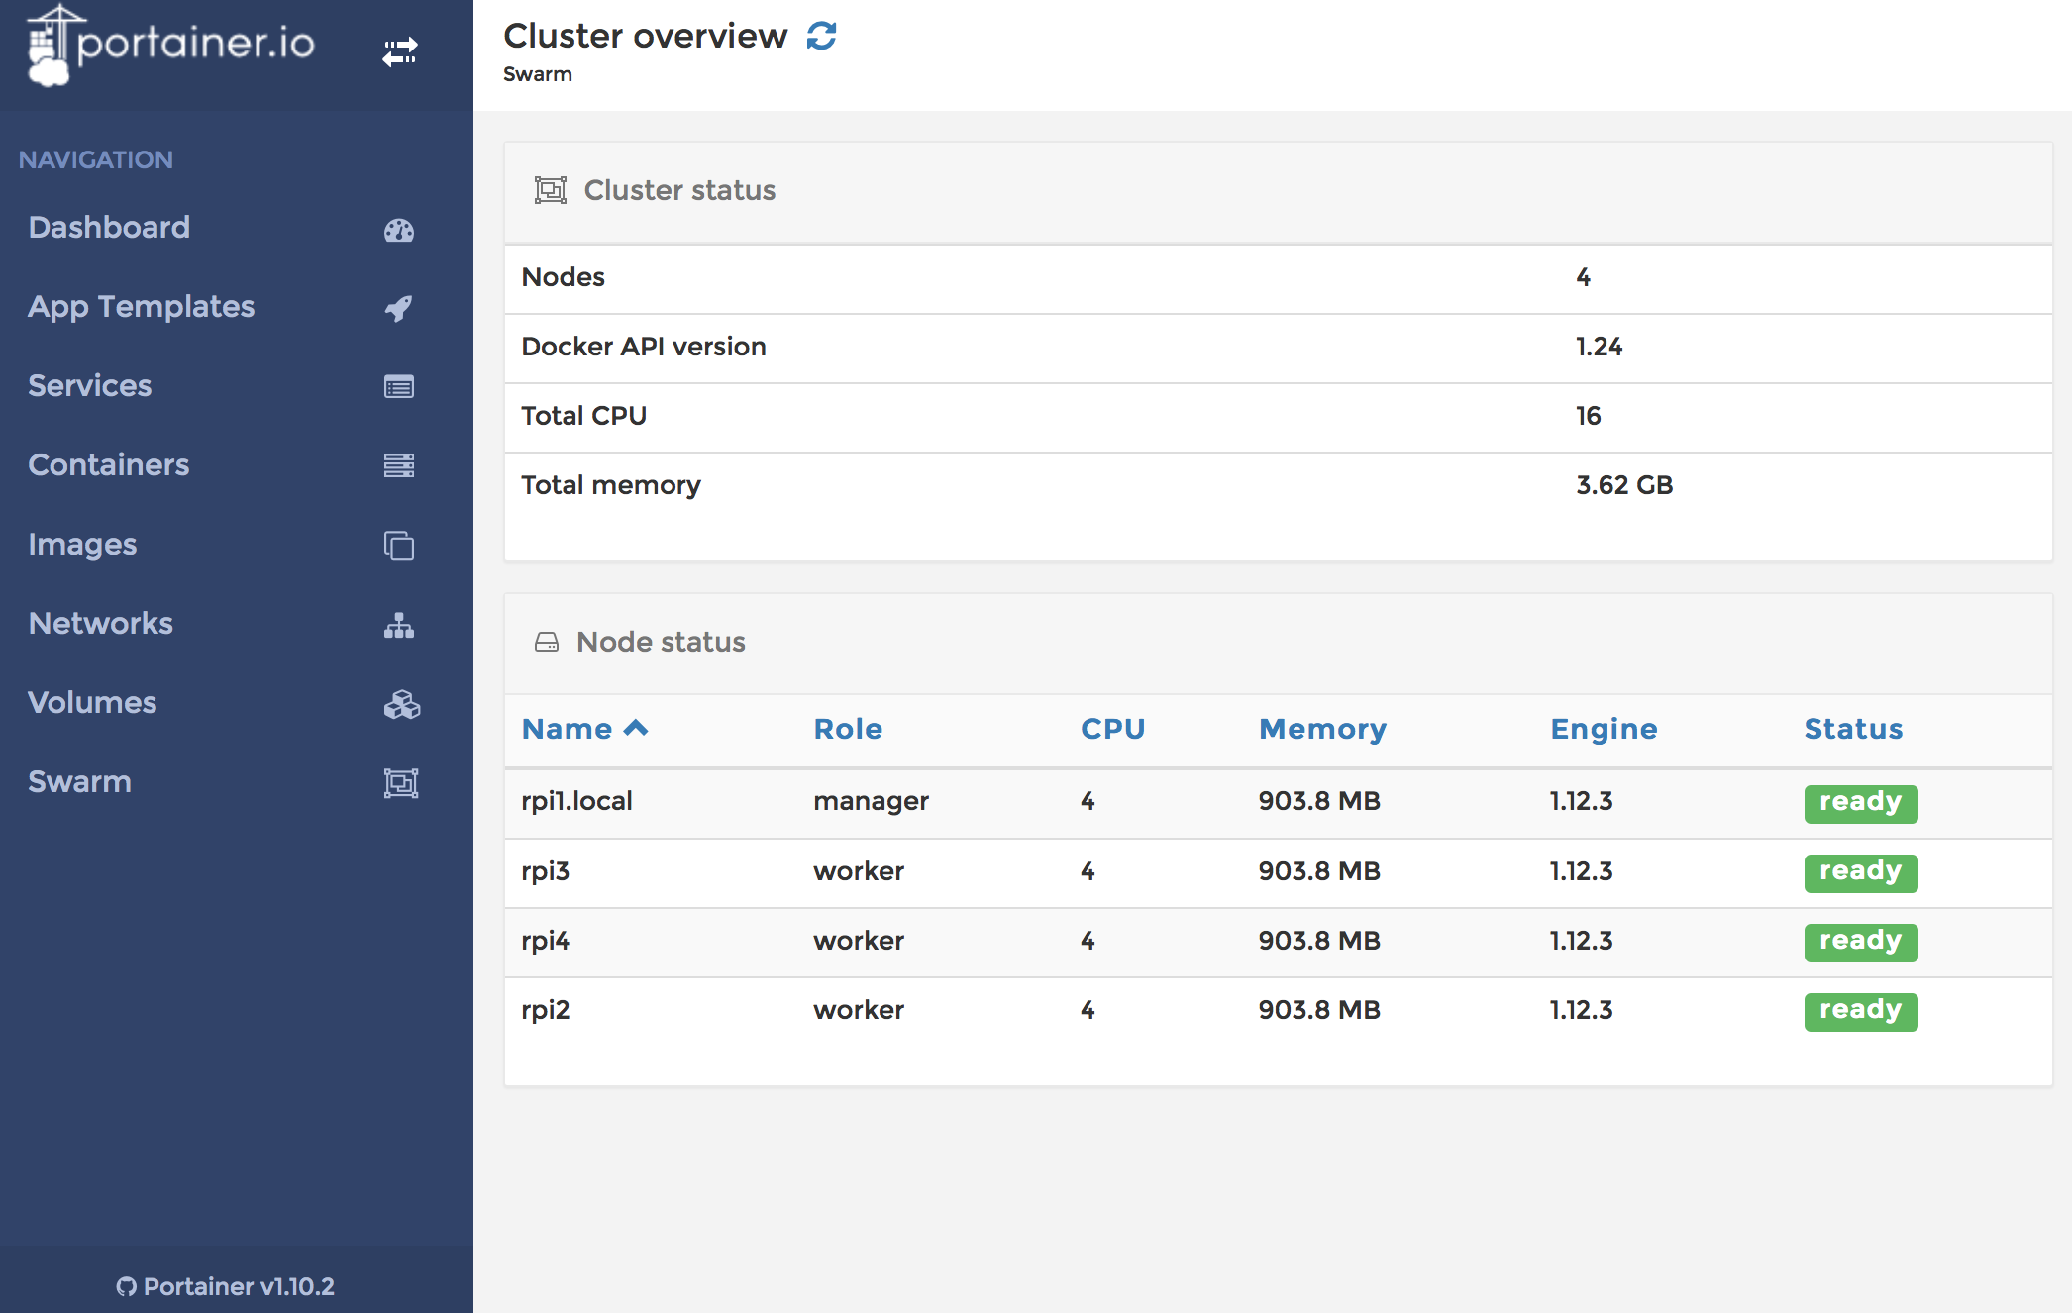
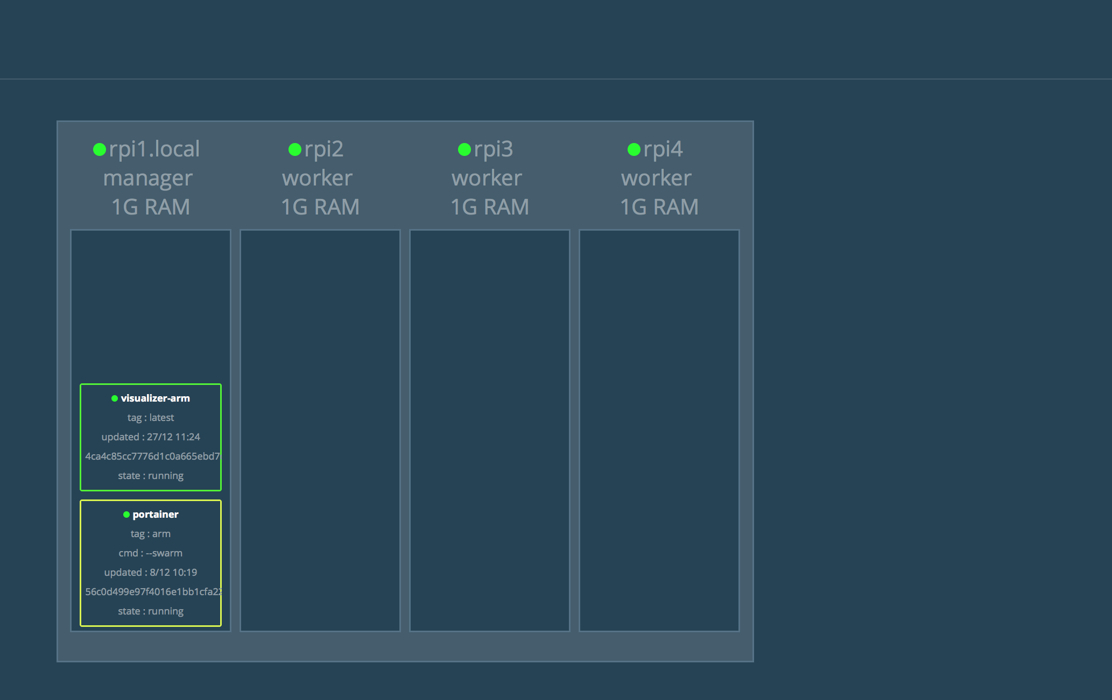
Docker Swarm Doing What?
> Docker service create –-name portainer –-publish 9000:9000 –-constraint ‘node.role==manager’ –mount type=bind,src=/var/run/docker.sock,dst=/var/run/docker.sock portainer/portainer:arm –swarm
>
> Docker service create –-name=viz --publish=8080:8080/tcp –-constraint=‘node.role==manager’ –-mount=type=bind,src=/var/run/docker.sock,dst=/var/run/docker.sock alexellis2/visualizer-arm:latest
Total Time: 5 mins & another cup of coffee

Slide 7
Docker Images
To create an image you need to do the following:
Make a directory and create a Dockerfile
Build it: docker build –t IMAGENAME .
Tag it: docker tag IMAGEID DOCKERHUBACCT/IMAGENAME:TAG
Push it:
Docker login
Docker push DOCKERHUBACCT/IMAGENAME
There are a couple useful images available on DockerHub that can help your Magento 2 project:
dhermans/rpi-mariadb
choukalos/rpi-redis
choukalos/magentopi*
Choukalos/rpi-php (php 5.6)
Psst:
> docker logs IMAGEID
> docker run –it IMAGENAME /bin/bash
Total Time: Lots – build & image debuging ☹
Notes:
Notes:
Each command builds a layer and is cached on your docker machine where you’re building the image. This takes up space so you should minize the # of layers you build
When building an image, you should treat the image as immutable. So if you need drive space you should create a mountable folder that can be linked when the image is run
To configure an image you should use environment variables. Commonly a .env file is injected when the image is run to manage this configuration
Public docker images are stored on dockerhub by default and can be retrieved without any special action on a machine running docker.
Creating DB images that have persistent storage is challenging. You want the persistent storage to be on a volume. However, volumes can’t be easily tied to a service nor is it easy to use with docker-compose. It’s recommended with a service you mount to a network attached file system or you constraint where the image runs to a particular node where you have a local mount point setup for it.
Services are still being created and don’t handle volume mounts very well at this point. Sounds like docker 1.13 start addressing this gap in feature set.

Slide 8
Deploying

Slide 9
A Multi-Machine Deployment
Swarm
Proxy
Magento2
MagentoN
Magento
Master (CRON)
MySQL (+Images)
Redis
Later to do:
Varnish
PHP 7.0.14 (+50% perf woot)
Switch to Alpine based images
Elasticsearch
Notes:
Alpine base image runs a few MB’s vs Raspabian based images at 400MB or so!

Slide 10
Supporting Services - Redis
Launch Redis, constrained to a node:
docker service create --name redis --constraint 'node.hostname == rpi4' --publish 6379:6379 hypriot/rpi-redis
Confirm Redis is working and accepting connections
telnet rpi4.local 6379
INFO
Total Time: 3-4 mins to pull image & run

Slide 11
Supporting Services - MariaDB
Launch MariaDB, constrained to the node using a Volume
On the node run (to build default mysql DB)
docker run -it -p 3306:3306 -v /mnt/data/docker/volumes/magentopi_db:/var/lib/mysql dhermanns/rpi-mariadb mysql_install_db
Docker exec –it CONTAINERID bash
> export TERM=dumb
> Mysql -uroot
Grant all privileges on *.* to ‘root’@’%’ with grant option;
Flush privileges;
Quit
exit
On your swarm manager run:
docker service create --name db --constraint 'node.hostname == rpi4' --publish 3306:3306 --mount type=bind,source=/mnt/data/docker/volumes/magentopi_db,target=/var/lib/mysql -e MYSQL_ROOT_PASSWORD=magento123 dhermanns/rpi-mariadb
Confirm DB is working another machine and accepting remote connections
mysql –hrpi4.local –uroot
create database magentopi
Total Time: ~10 mins to pull image & etc

Slide 12
Idea: Magento Split Deploy Flow
Ideally: 10-15 mins + coffee
Get Code
Composer Install
Install Magento*
Configure Magento
Save to Git/Build an Image (build process does compile & static asset)
Dev Machine
Ideally: < 1 min + coffee
Prep: Setup Deployment Architecture/Infrastructure
Maintenance Mode On
Pull latest code/image
Schema Update (install or upgrade)
Flush Caches
[Warm Cache]
Maintenance Mode Off
Prod/Staging Machine
Notes:
But; this isn’t reality on Raspberry Pis!
More like build the image for an hour or two; then just pulling/spinning up the image is like 30 minutes on a PI!!!!

Slide 13
Configuring Tips Magento 2
Use Redis for Caches:
Setup Redis Session Caching (link) by editing app/etc/env.php
Setup Redis caching (all but page, link) by editing app/etc/env.php and specifying ‘default’ array
Use Varnish for Page Caches:
Configure Varnish (link) by manipulating the admin panel/config/… and generate the VCL. Note this edits app/etc/env.php & provides a generated VCL file that needs to be added to your Varnish server.
Set Production Mode, Configure for Performance:
Minify HTML
Minify, Merge & Bundle JS
Merge CSS
Easiest (now) to just configure on your dev machine and do an app:config:dump there
Ideal if we had docs or CLI tool to help out. Maybe a standard template would be another way to approach it?
Total Time: Gah! ☹

Slide 14
Building Magento 2.1.3 Image
On your development machine
Git clone choukalos/magentopi:test
Unzip MagentoCE into /src directory
Composer install (alternatively composer upgrade for upgrades)
Configure Magento
Install Magento* via CLI
Tweak config via Admin Panel
bin/magento app:config:dump
Manually tweak: config.local.php, env.php
bin/magento setup:di:compile
bin/magento setup:static-asset:deploy
Git add .
Git commit –m “Magento is Built for Production”
Git push origin master
Rebuild the Docker Image and push to Dockerhub/Docker Repo
CD to image root directory
Docker build –t magentopi .
Docker tag IMAGEID choukalos/magentopi:TAGNAMEFORDEPLOYMENT
Docker push choukalos/magentopi
Build Process
Docker
Whoops!
Total Time: 10-15 mins to do code/config Magento; 60-90 mins to build Docker image
Notes:
Note
* there’s a bug where you need to have the DB available to do a compile; this should be resolved in 2.2 , and added to a 2.1.x branch
Flow’s odd; since you have to have the DB first before you can dump the config.local.php file
To install Magento*
php bin/magento setup:install --admin-firstname="chuck" --admin-lastname="choukalos" \
> --admin-email="chuck@x.com" --admin-user="magento" --admin-password="magento123" \
> --base-url="http://pi.choukalos.org" --backend-frontname="admin" --db-host="localhost" \
> --db-name="magentopi" --db-user="root" --cleanup-database

Slide 15
Deploying Magento
Doesn’t Really Work
Launch the web service:
docker service create --name magenode --publish 80:80 choukalos/magentopi:2.1.3RC4
Deploy (do this only on 1 node)
docker exec –it CONTAINERID bash
cd /var/www/html
php bin/magento setup:install … or setup:upgrade
Php bin/magento cache:flush
Launch the cron service:
docker service create --name magemaster --env 'MODE=cron' choukalos/magentopi:2.1.3RC4
Scale the web service:
docker service scale magenode=4
Docker Swarm Issues
Must have code in Image*
Image is then too big; # of issues
Notes:
Install:
bin/magento setup:install --admin-firstname="chuck" --admin-lastname="choukalos" \
--admin-email="chuck@x.com" --admin-user="magento" --admin-password="magento123" \
--base-url=”pi.choukalos.org" --backend-frontname="admin" --db-host=”192.168.1.135" \
--db-name="magento" --db-user="root" --cleanup-database
# update command
bin/magento setup:upgrade --keep-generated

Slide 16
Swarm !=Happy
But ….

Slide 17
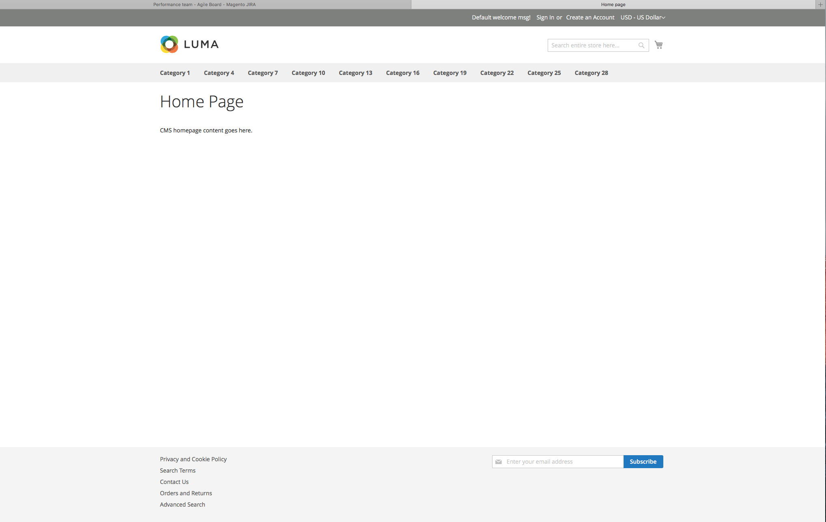
Make it Live!
So just used normal Docker Run command on a node to run Magento with code in a volume
Notes:
Note bugs:
Bug in generating performance fixtures on a production machine (perf team has this item in their backlog, toolkit tries to write files it shouldn’t)
Kept having issues with SQL generation speed; so build db on my laptop and copied over to RPI DB server

Slide 18
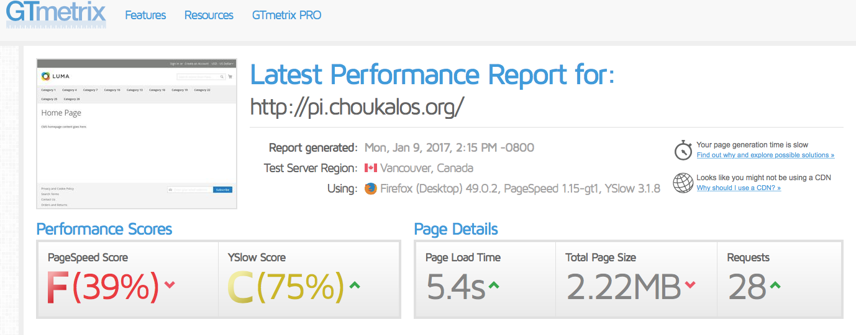
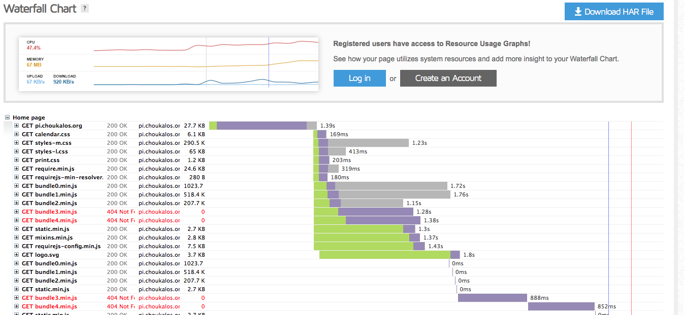
Performance
D’oh:
No compression
No varies headers
Cached in Redis ☹
Notes:
Look at that… it’s 1.2s just to get the server response ; that’s why you use Varnish ...
Opcache turned on/tuned and PHP7 would go a long way to improving that speed even on a RPI

Slide 19
Learned - Docker
Building Images:
It’s really slow building images on a Raspberry PI B2 (up to an hour!)
Every FROM,RUN, CP, and ADD command is a separate layer so consolidate as much as possible into a layer as you want your image as small as possible
*The Magento Compile/Static Asset commands should be done during Image build and not checked into Git
Use Environment variables to pass info into your container when launched
*I cheated and checked in/build with Env.php
Volumes:
When you first initialize you’ll need to work interactively with the container to populate most likely (DB initialization for example)
Services:
Still work in progress with respect to Volumes; Bind volume has to be local to the node the image runs on
Once it caches a tagged image it keeps using it – so you need to have a unique tag for every image you want to deploy from a repo (like Dockerhub)
*No idea how to link services
Constraints not fully fleshed out; really want to say 1 container/node in a swarm….
I got cron to work as a separate service; but it seems kludgy at best
Docker:
Scaling services is cool if you don’t need volumes for each container
Debuging when a container launched by a service fails stinks – you have to go to the node the container launched on and docker logs to see. Note too that docker services cleans up containers/logs on nodes it launches them on
Pulling a big image on a Raspberry PI can take up to 30 minutes!
Not production ready
Notes:
Docker/Swarm needs:
- add’l volume management capabilities
service linking
Issues with large images and service prep/deployment (my large image kept failing, in addition to taking too long to deploy – aka 30 mins)

Slide 20
Learned - Magento Deploy
Configuration Variables:
Have to have DB/set in admin panel on dev box, then app:dump:config to get the settings
Asked Falcons – re env.php variables & how to set their environmental variable overrides
Build Process:
We’ve got bugs that need to be cleaned up
No CLI commands or easy doc’s on setting up deployment architecture items: Varnish Cache, Search Engines, Performance Optimizations, Payment, Shipping, Websites/Storeviews (good for Redis/Session caching though)
Deploy Process (Docker Service):
Gah!!!!
Need to improve experience (goal of 2.2)
CLI tooling
Docs
Notes:
?Maybe validation on configuration?

Slide 21
Appendix

Slide 22
Resources
Magento Config; https://wiki.corp.magento.com/pages/viewpage.action?spaceKey=MAGE2&title=Split+Deployment+-+Scrub+sensitive+data
Docker Images, Notes, Etc from this presentation: https://github.com/choukalos/docker
Hypriot Blog, Hypriot OS RPI image: http://blog.hypriot.com
Dockerhub – community created Docker images; you’ll need to search on RPI or Raspberry PI: https://hub.docker.com
Docker – main site : https://www.docker.com
Docker v1.13 released with enhanced services mode: https://codefresh.io/blog/deploy-docker-compose-v3-swarm-mode-cluster/
Interesting
Functions as a Service on Docker (aka Lambda): http://blog.alexellis.io/functions-as-a-service/
GCE Kubernates Hosting - https://cloud.google.com/container-engine/

